Slide 1
Machine Learning DASC 522
Introduction to Machine Learning
Dr. Torrey Wagner

Slide 2
Overview
Machine Learning Overview
What you can & can’t do with Machine Learning
Review of Statistical Learning
Quality of Fit
Slide used from AFIT CSCE 623 Machine Learning Course

Slide 3
Overview
Machine Learning Overview
What you can & can’t do with Machine Learning
Review of Statistical Learning
Quality of Fit

Slide 4
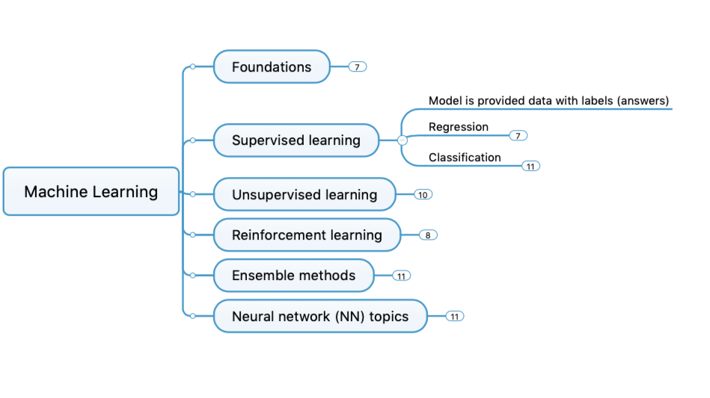
Concept Map

Slide 5

JAIC AI Explainer

Slide 6
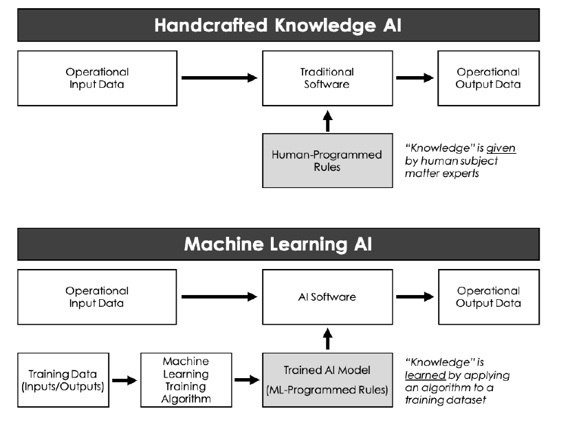
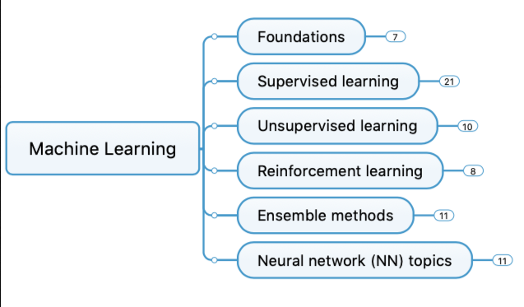
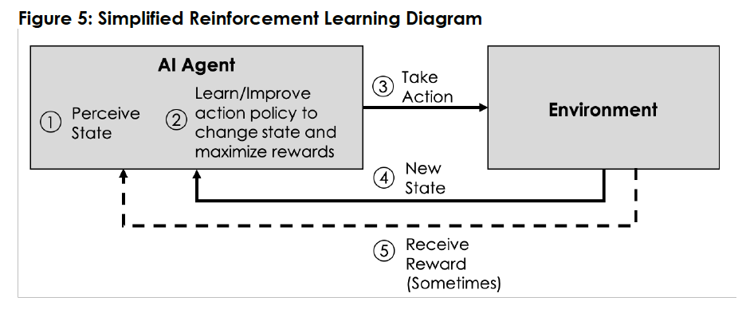
JAIC AI Explainer
Graphics from 2020 DoD Understanding AI Technology

Slide 7
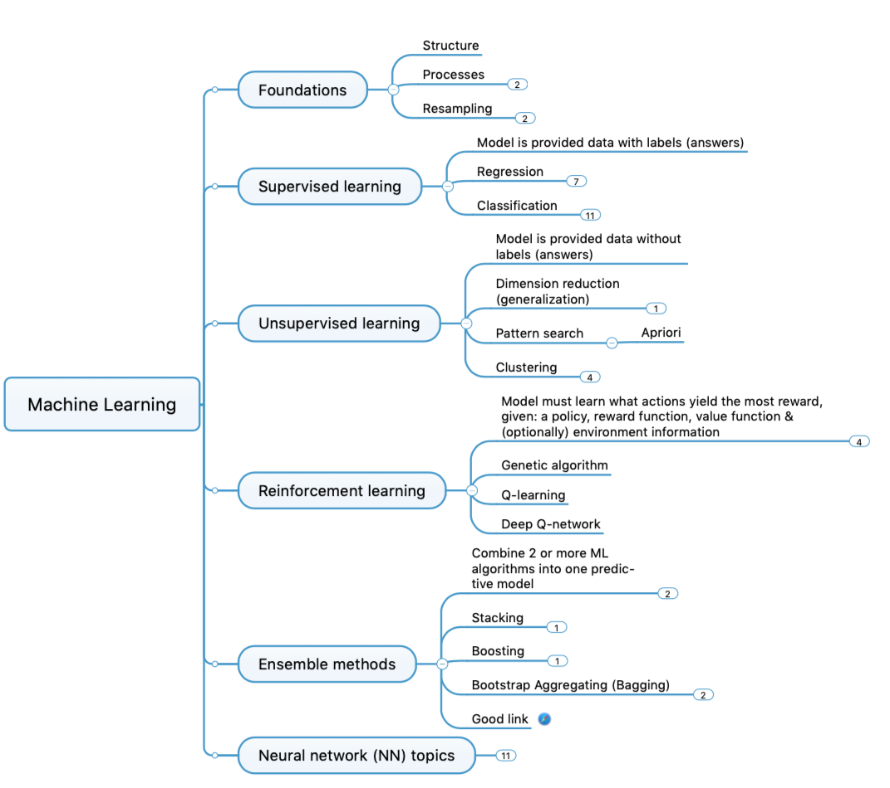
Concept Map

Slide 8
Overview
Machine Learning Overview
What you can & can’t do with Machine Learning
Review of Statistical Learning
Quality of Fit

Slide 9
A short history of the world…
Humans made decisions
Language, Math & Logic are created and people write rules for making decisions
Computers invented: able to make faster decisions
Humans write fixed programs to make decisions using (probabilistic) distilled judgements about relationships in the data [Handcrafted]
Humans decided that the computer would be better at learning relationships between attributes of the data [Machine Learning]
Slide from Dr. Brett Borghetti, AFIT/ENG CSCE 623 Statistical Machine Learning course, 2019SP

Slide 10
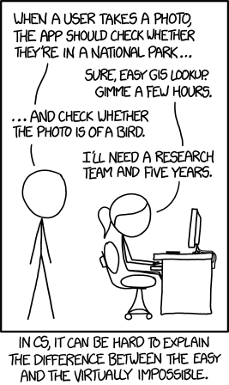
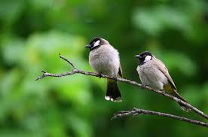

What can you do with Machine Learning? 1 of 2
Infer how data elements are related
Does ice cream consumption depend on outdoor temperature?
Make predictions about a target variable within a dataset
How much ice cream will be consumed this summer in Ohio?
Determine the category something belongs to
Bird vs non-bird
https://www.pexels.com/search/birds/
https://en.wikipedia.org/wiki/Strelitzia
Slide from Dr. Brett Borghetti, AFIT/ENG CSCE 623 Statistical Machine Learning course, 2019SP
xkcd #1425 (View original here)

Slide 11
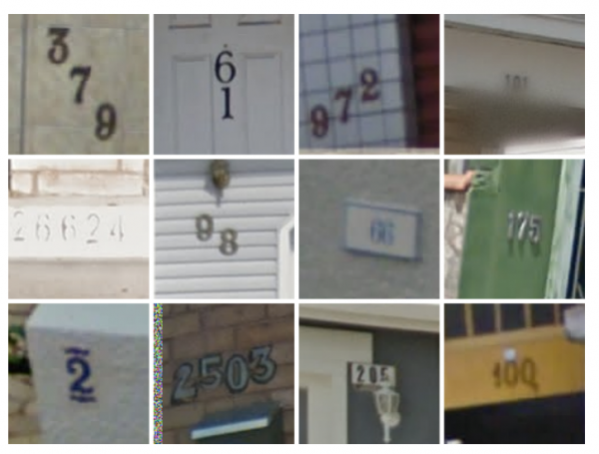
What can you do with Machine Learning? 2 of 2
Optical Character/Number recognition
Translate Text between languages
Audio<->Text
Find Components of an image
Describe the contents of an image
Pick the best <restaurant; movie; product; …> for me
https://www.technologyreview.com/s/523326/how-google-cracked-house-number-identification-in-street-view/
Slide from Dr. Brett Borghetti, AFIT/ENG CSCE 623 Statistical Machine Learning course, 2019SP

Slide 12
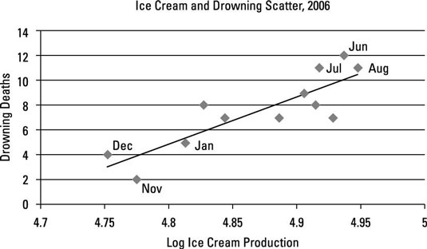

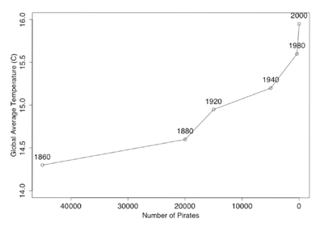
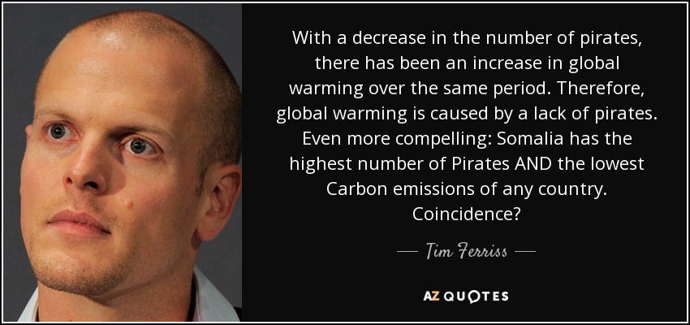
What can’t you do with ML? 1 of 2
Determine causality
Production of ice cream is correlated with drowning. Which way is the causality?
Determine whether data is Evidence or Coincidence
http://www.dummies.com/education/economics/ econometrics/the-role-of-casuality-in-econometrics/
http://sourcesandmethods.blogspot.com/2011/03/passport-ownership-cures-diabetes.html
Slide from Dr. Brett Borghetti, AFIT/ENG CSCE 623 Statistical Machine Learning course, 2019SP

Slide 13
What can’t you do with ML? 2 of 2
Overcome bad data
Insufficient Quantity of Training Data
Nonrepresentative Training Data
Poor-Quality Data
Humans need to be aware of challenges
Decide what Features are relevant
Detect Overfitting
Detect Underfitting
HOML Ch 1

Slide 14
What can’t you do with just ML (2)
Find the fastest route to an address on a map (use a cost-based pathfinding algorithm)
Learn to Play Chess, Checkers, Go (efficiently) (use a heuristic deep search algorithm)
Determine geocoordinates from only a photo (this only works for some common locations…)
Drive a vehicle autonomously (this requires much more than ML)
Slide from Dr. Brett Borghetti, AFIT/ENG CSCE 623 Statistical Machine Learning course, 2019SP

Slide 15
Overview
Machine Learning Overview
What you can & can’t do with Machine Learning
Review of Statistical Learning
Quality of Fit

Slide 16
What is Statistical Learning?
Suppose we observe and for
We believe that there is a relationship between Y and at least one of the X’s.
We can model the relationship as
Where f is an unknown function and ε is a random error with mean zero.
Slide from Dr. Brett Borghetti, AFIT/ENG CSCE 623 Statistical Machine Learning course, 2019SP

Slide 17
A Simple Example
Slide from Dr. Brett Borghetti, AFIT/ENG CSCE 623 Statistical Machine Learning course, 2019SP

Slide 18
A Simple Example
ε_{i}
f
Slide from Dr. Brett Borghetti, AFIT/ENG CSCE 623 Statistical Machine Learning course, 2019SP

Slide 19
Different Standard Deviations
The difficulty of estimating f will depend on the standard deviation of the ε’s.
Slide from Dr. Brett Borghetti, AFIT/ENG CSCE 623 Statistical Machine Learning course, 2019SP

Slide 20
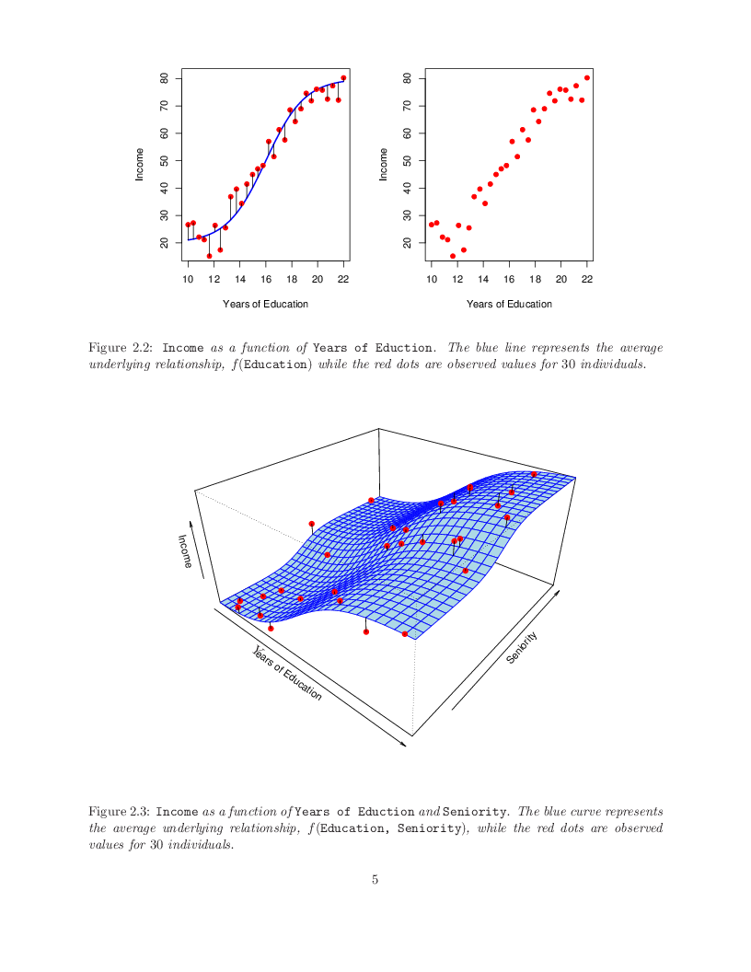
Income vs. Education & Seniority
Shown above is the “true” relationship between the variables Years of Education, Seniority, and Income.
CONCEPT CHECK: Describe the relationship between income, years of education and seniority that you see here
Slide from Dr. Brett Borghetti, AFIT/ENG CSCE 623 Statistical Machine Learning course, 2019SP

Slide 21
Why Do We Estimate f ?
Statistical Learning, and this course, are all about how to estimate f.
The term statistical learning refers to using the data to “learn” f.
Why do we care about estimating f ?
There are 2 reasons for estimating f,
Prediction (Estimation)
Inference (Explanation)
Slide from Dr. Brett Borghetti, AFIT/ENG CSCE 623 Statistical Machine Learning course, 2019SP

Slide 22
Prediction / Estimation Example: Direct Mailing Decision
How much money an individual will donate to a charity?
Data:
X: 400 characteristics about each person
Y: How much they donated.
Business Question: For a given individual should I send out a mailing?
Is the expected value of taking the action greater than the cost of the action?
Slide from Dr. Brett Borghetti, AFIT/ENG CSCE 623 Statistical Machine Learning course, 2019SP

Slide 23
Inference (Explanation)
We may also be interested in the type of relationship between Y and the X's.
For example,
Which particular predictors (features) actually affect the response?
Is the relationship positive or negative?
Is the relationship a simple linear one or is it more complicated?
Slide from Dr. Brett Borghetti, AFIT/ENG CSCE 623 Statistical Machine Learning course, 2019SP

Slide 24
Inference Example: Understanding Home prices
How do characteristics affect home prices
Housing data:
X: 14 characteristics (e.g. number of beds; baths; square feet)
Y: cost of the home
Business Question:
How would altering the variables affect my home’s value?
For example
Would installing an in-ground pool increase my home’s value?
What is the financial impact of turning my 1-car garage into a woodworking shop?
What is the most cost-effective thing I could do to improve my home’s value before I sell it?
Slide from Dr. Brett Borghetti, AFIT/ENG CSCE 623 Statistical Machine Learning course, 2019SP

Slide 25
How Do We Estimate f ?
We will assume we have observed a set of training data
We must then use the training data and a statistical method to estimate f.
Statistical Learning Methods:
Parametric Methods
Non-parametric Methods
|Features| = m (or p)
Target Label
X_{:,1} | X_{:,2} | … | X_{:,m}
X₁
Y₁
X₂
Y₂
|Observations| = n
…
…
X_{n}
Y_{n}
Slide from Dr. Brett Borghetti, AFIT/ENG CSCE 623 Statistical Machine Learning course, 2019SP

Slide 26
Parametric Methods
Reduces the problem of estimating f to estimating a set of parameters.
Two-step model based approach
STEP 1:
Make some assumption about the functional form of f, i.e. come up with a model. For example, a linear model:
Slide from Dr. Brett Borghetti, AFIT/ENG CSCE 623 Statistical Machine Learning course, 2019SP

Slide 27
Parametric Methods (cont.)
STEP 2:
Use the training data to fit the model i.e. estimate f or equivalently the unknown parameters such as β₀, β₁, β₂,…, β_{p}.
Individual prediction error terms can be computed:
One common approach for estimating the parameters in a linear model is ordinary least squares (OLS) – which minimizes the square of the sum of the error terms.
Has limitations due to computational tractability of inverting a matrix
There are other approaches
Slide from Dr. Brett Borghetti, AFIT/ENG CSCE 623 Statistical Machine Learning course, 2019SP

Slide 28
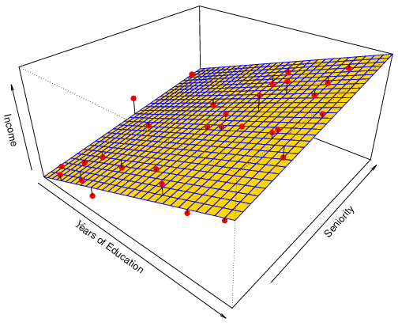
Parametric Example: Linear Regression
Linear Model Approximation
True Phenomenon
Slide from Dr. Brett Borghetti, AFIT/ENG CSCE 623 Statistical Machine Learning course, 2019SP

Slide 29
Non-parametric Methods
Includes neural networks
Non-parametric methods do not make explicit assumptions about the functional form of f
There is no parametric model, and no model parameters are fit from the data during the training process
Instead, (some) data observations from the training set are stored and used (directly) during prediction
Advantages: accurately fit a wider range of possible f
Disadvantages: Slower to train; Risk of overfitting; A very large number of observations are required to obtain an accurate estimate of f
Slide from Dr. Brett Borghetti, AFIT/ENG CSCE 623 Statistical Machine Learning course, 2019SP

Slide 30
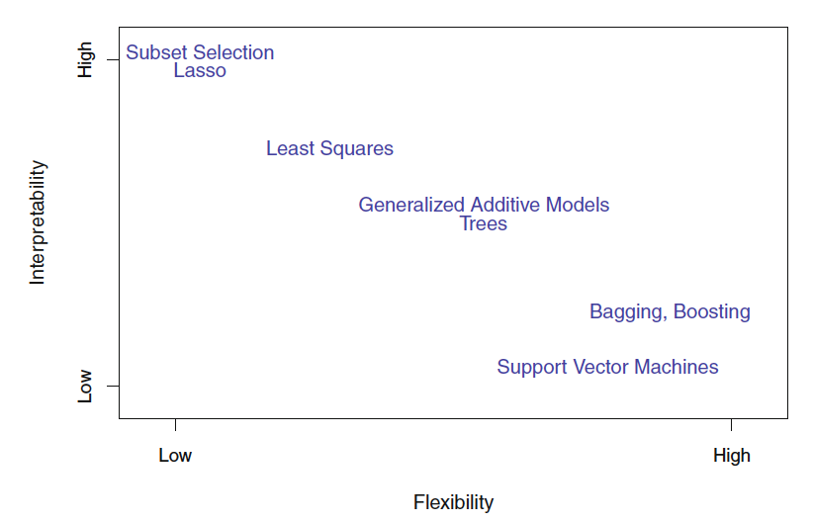
Flexibility in Non-parametric Methods
Fig 2.7 ISLR

Slide 31
Overview
Machine Learning Overview
What you can & can’t do with Machine Learning
Review of Statistical Learning
Quality of Fit

Slide 32
Measuring Quality of Fit
How do we evaluate a regression model’s performance?
One way: mean squared error (MSE):
Where is the prediction our method gives for the observation in our training data.
CONCEPT CHECK: What is n in the equation?
Which is better – a higher, or a lower MSE?
Why do we use mean squared error instead of mean error?
Slide from Dr. Brett Borghetti, AFIT/ENG CSCE 623 Statistical Machine Learning course, 2019SP

Slide 33
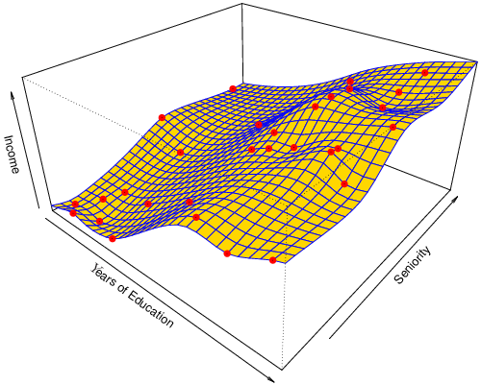
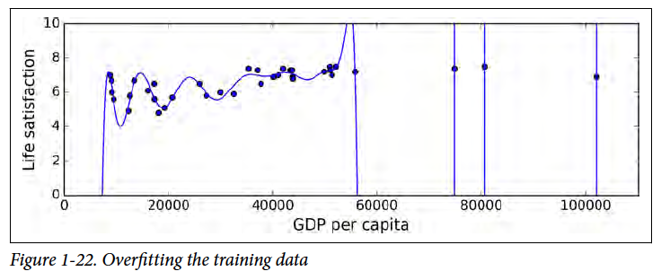
Overfitting
A model can be too flexible, and make poor estimates of f on unseen data. This is also known as failure to generalize
Overfit model (Fitted to the noise in the data)
True Phenomenon in Blue
Graphic to the right is HOML Fig 1-22
Slide from Dr. Brett Borghetti, AFIT/ENG CSCE 623 Statistical Machine Learning course, 2019SP

Slide 34
Training vs. Test set performance
Model Fitting: Choose model parameters such that MSE is minimized on the Training Data
What we really care about is how well the method works on data that was not used for training (i.e. Test Data). Test data performance indicates the model’s ability to generalize.
There is no guarantee that the method with the smallest training MSE will have the smallest test MSE. If training performance is good and test performance is bad, the model has failed to generalize.
Slide from Dr. Brett Borghetti, AFIT/ENG CSCE 623 Statistical Machine Learning course, 2019SP

Slide 35
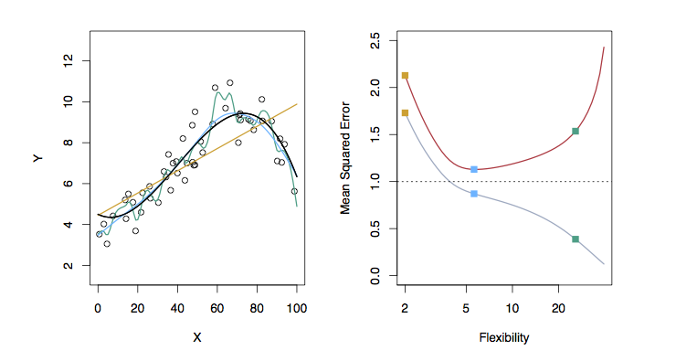
Examples with Different Levels of Flexibility: Example 1
TestMSE
Linear Model
More flexible smoothing spline
Smoothing Spline
TrainingMSE
Black: Truth
Orange: Linear Estimate
Blue: smoothing spline
Green: smoothing spline (more flexible)
RED: Test MSE
Grey: Training MSE
Dashed: Minimum possible test MSE (irreducible error)
CONCEPT CHECK: Where does “irreducible error” come from?
Slide from Dr. Brett Borghetti, AFIT/ENG CSCE 623 Statistical Machine Learning course, 2019SP

Slide 36
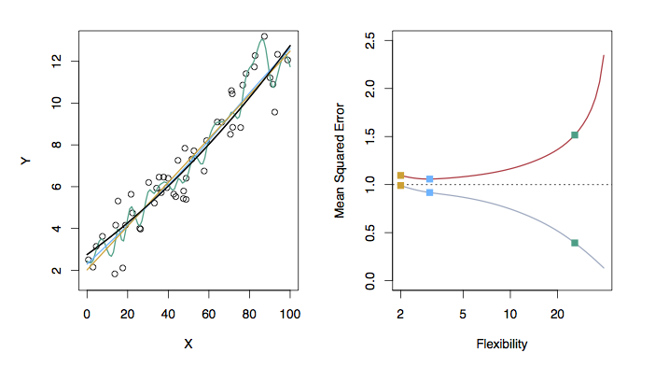
Examples with Different Levels of Flexibility: Example 2
TestMSE
More flexible smoothing spline
Smoothing Spline
Linear Model
TrainingMSE
Black: Truth
Orange: Linear Estimate
Blue: smoothing spline
Green: smoothing spline (more flexible)
RED: Test MSE
Grey: Training MSE
Dashed: Minimum possible test MSE (irreducible error)
Slide from Dr. Brett Borghetti, AFIT/ENG CSCE 623 Statistical Machine Learning course, 2019SP

Slide 37
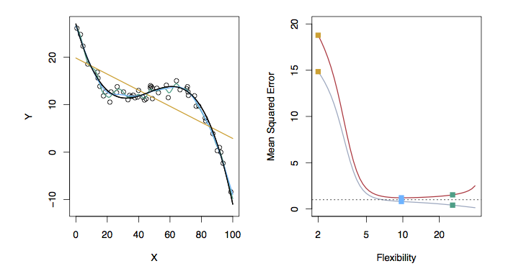
Examples with Different Levels of Flexibility: Example 3
TestMSE
Linear Model
More flexible smoothing spline
Smoothing Spline
TrainingMSE
Black: Truth
Orange: Linear Estimate
Blue: smoothing spline
Green: smoothing spline (more flexible)
RED: Test MSE
Grey: Training MSE
Dashed: Minimum possible test MSE (irreducible error)
Slide from Dr. Brett Borghetti, AFIT/ENG CSCE 623 Statistical Machine Learning course, 2019SP

Slide 38
Best Approach
Train on training set
Evaluate on validation set
Use feedback to tune hyperparameters
THEN confirm results on test set

